Slide 1

Ames Housing Price Prediction
Ivy Chan

Slide 2
Problem Statement
To create a Model based on the Ames Housing Dataset to predict the price of a house.
To Identify what are the features that will influence price of a house in Ames.

Slide 3
Background
Data set contains information from the Ames Assessor’s Office used in computing assessed values for individual residential properties sold in Ames, IA from 2006 to 2010.
Training Data
2051 rows of observations with 81 columns
Test Data
879 rows of obseravtions with 80 columns

Slide 4
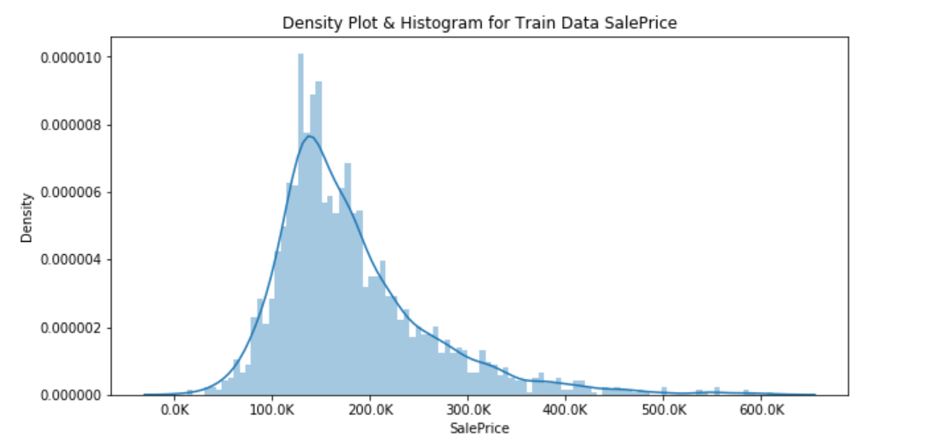
Distribution of Target in Traning Data

Slide 5
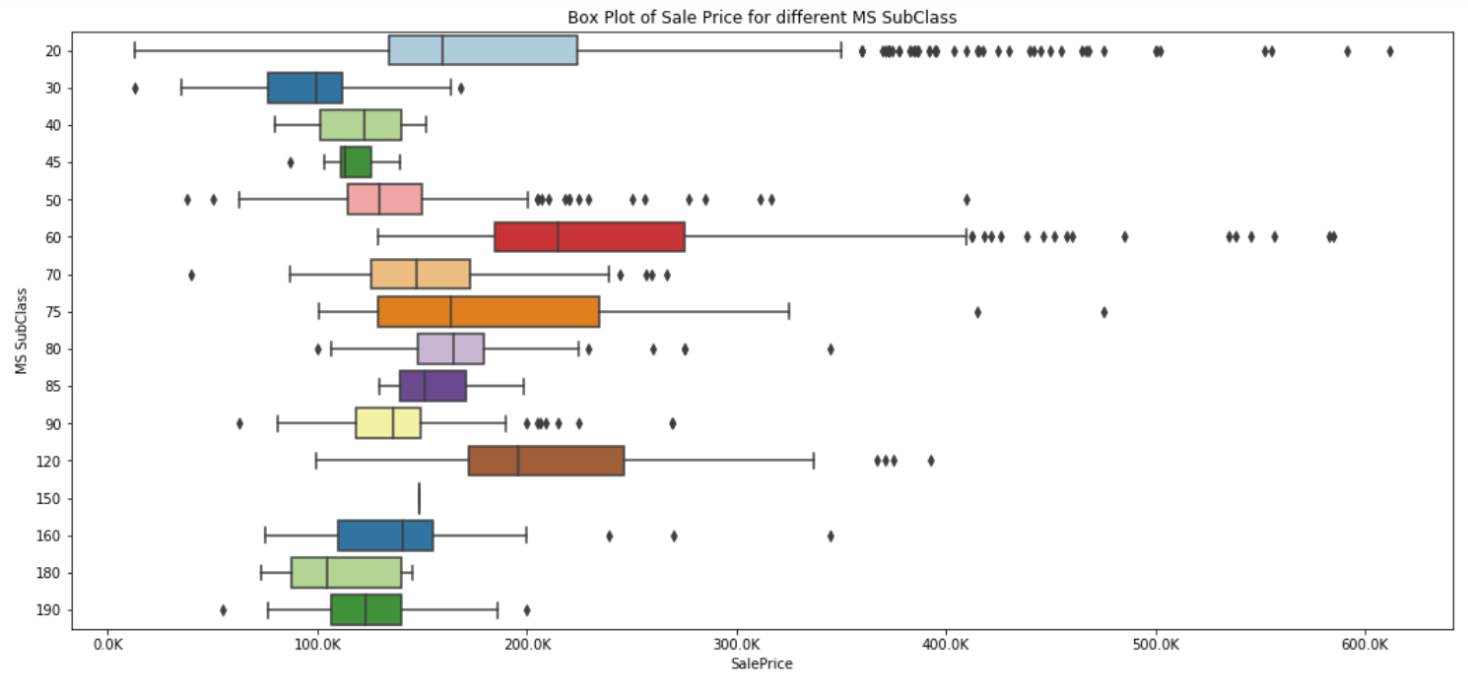
Box Plot of Sale Price for different MS SubClass

Slide 6
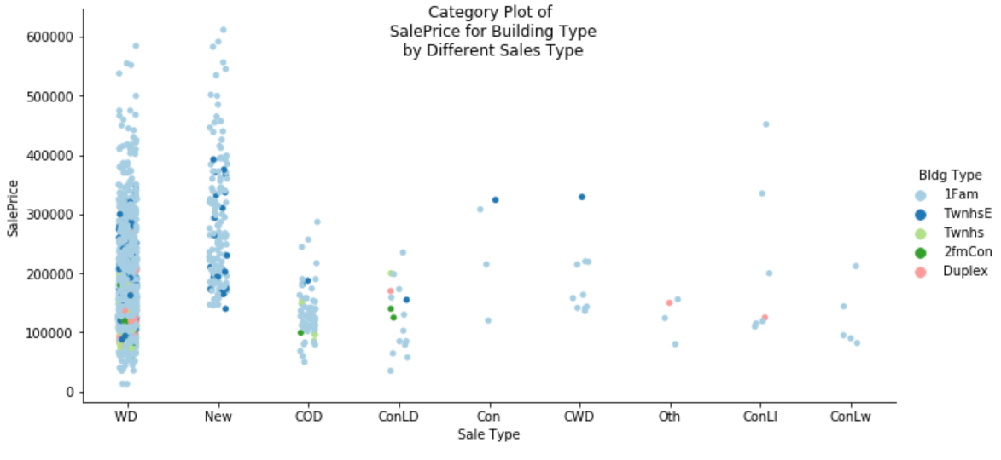
Category Plot of SalePrice for Building Type by Different Sales Type

Slide 7
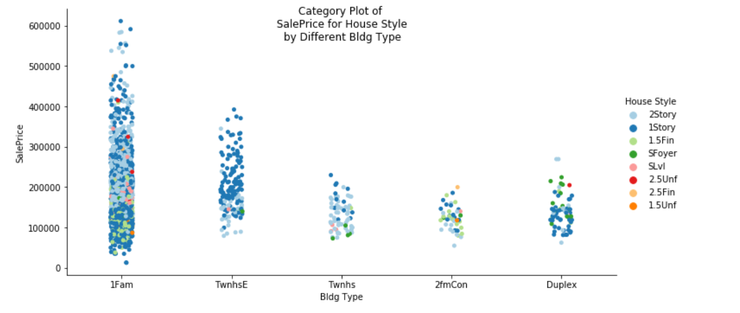
Category Plot of SalePrice for House Style by Different Bldg Type

Slide 8
Introduce New features & Interaction Term
Property Age
Remodel Age
Remod/Add
Overall Qual*Exter Qual
Lot Area*Remodel Age
Property Age*Lot Area
Gr Liv Area*TotRms AbvGrd

Slide 9
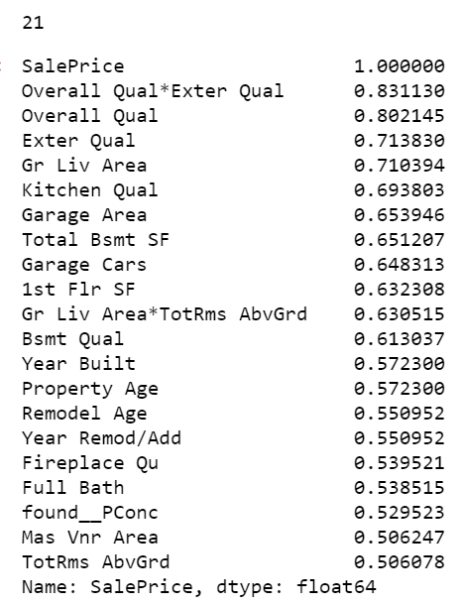
Feature Selection: Filtering method

Slide 10
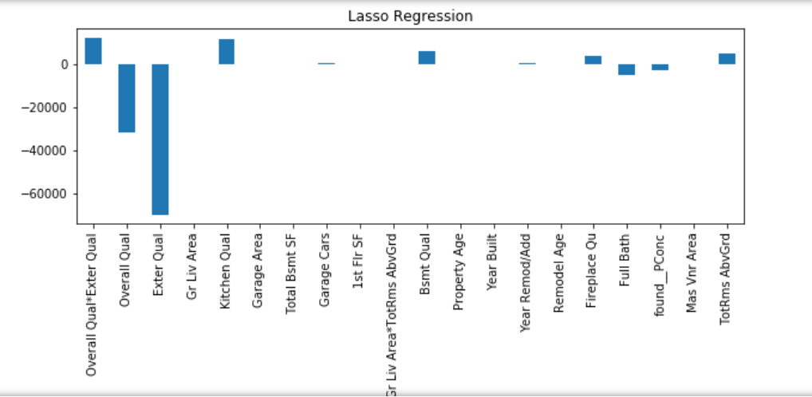
Lasso

Slide 11
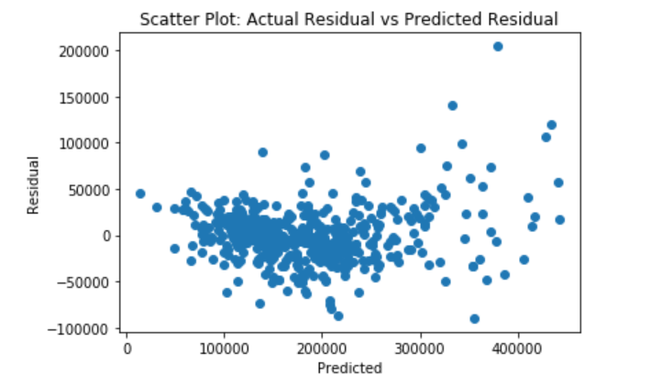
Actual vs Predicted Residual

Slide 12
Conclusion
Top features 9 that influences House sale Price are:
External Quality,
Overall Quality,
Interaction of External Quality & Overall Quality,
Kitchen Quality,
Basment Quality,
Full Bath,
Poured Contrete Foundation
Total Room Above Ground and
FirePlace Quality.

Slide 13
THANK YOU

